Slide 1

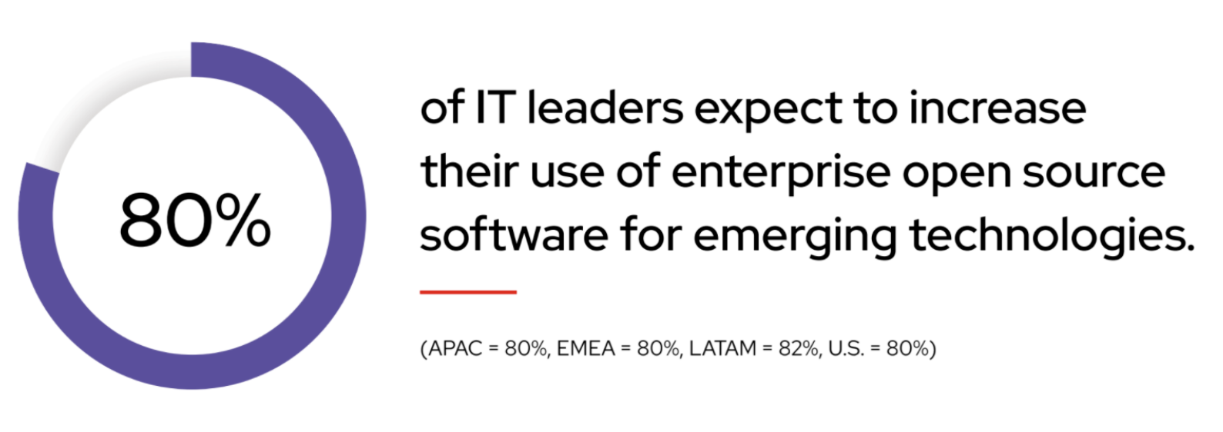
z/OS Open Source Guild Meetings Igor Todorovski (itodorov@ca.ibm.com) Mike Fulton (fultonm@ca.ibm.com)
Guild Meeting #1
August 17, 2022
Source: https://www.redhat.com/en/resources/state-of-enterprise-open-source-report-2022
IBM IMS / © 2020 IBM Corporation

Slide 2
Agenda
Motivation behind z/OS Open Source Software (OSS) Initiative (5 mins)
Goals for the OSS Guild (5 mins)
Where we are today (5 mins)
Demonstration (20 mins)
How you can get involved (5 mins)
Survey (10 mins)
Q/A (15 mins)

Slide 3



Open Source on z/OS? Why are we so behind?
Gaps in our foundation
Common building blocks like Git, Curl, Make, Perl, Compilers are outdated or non-existent
Proprietary Ports
Ports are not upstreamed and/or proprietary
Translates to significant maintenance cost and/or abandoned support
Limited System Access
Barrier to entry: open source projects do not have access to port/test to z/OS
As z/OS modernizes, the gaps in supported OSS are becoming more and more obvious
z/OS is at least 50% behind Mac, Ubuntu and Red Hat
We need a better way to facilitate open source development on z/OS
Notes:
Ok, now, let’s talk about Open source on z/OS? A common question is why? When you have Linux on z?
As we continue to modernize the platforms and introduce new technologies, we are finding that many of the core tools that are present on Mac, Ubuntu and Red-hot are not available on z/OS.
In fact, z/OS only has 50% of the utilities that are provided on a barebones linux machine.
So why are so behind?

Slide 4
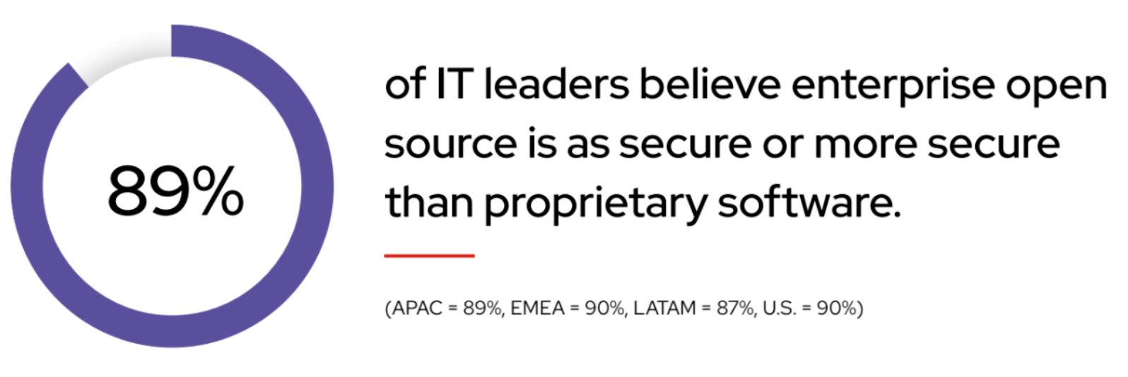
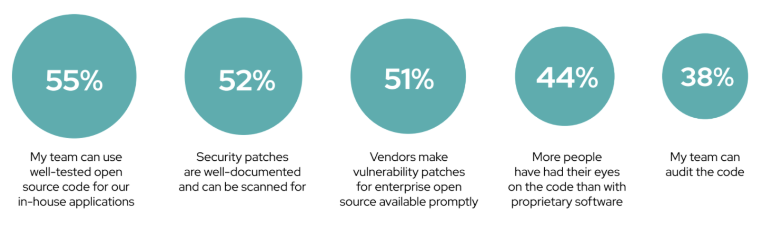
z/OS is known for security and Open Source is not secure right? Wrong!
Why security is a benefit of enterprise open source
Source: https://www.redhat.com/en/resources/state-of-enterprise-open-source-report-2022

Slide 5



z/OS Open Source Guild - Goals
Build a z/OS Open Source community and ecosystem!
Monthly touchpoint meetings on the latest in z/OS Open Source
Collaborate and promote open source on z/OS
Kick-start by porting the core OSS tools to z/OS and engaging with the entire OSS community!
The z/OS Open Source Guild is completely Open!
Everything is hosted on Github
Discussion, patches, binaries, guild recordings and more!
Key: Upstream! Upstream! Upstream!
Grant the community z/OS system access so they adopt z/OS as a platform of choice
Grant both Development and Deployment system access

Slide 6
z/OS Open Source Initiative https://github.com/ZOSOpenTools

Slide 7






Where we are now?
Started in Q1 2022
Grown to 40 OSS tools/libraries being ported to z/OS
Community binaries are being published to GitHub via CI/CD pipeline
Builds and most tests passing
m4
make
perl
Builds but several tests failing
automake
coreutils
autoconf
bison
gzip
help2man
jq
libtool
makeinfo
openssl
tar
xz
zlib
xxhash
gettext
zstd
Does not build
curl
expat
gawk
git
lz4man-db
rsync
tcl
top
z/OS fits into Open Source, not the other way around

Slide 8
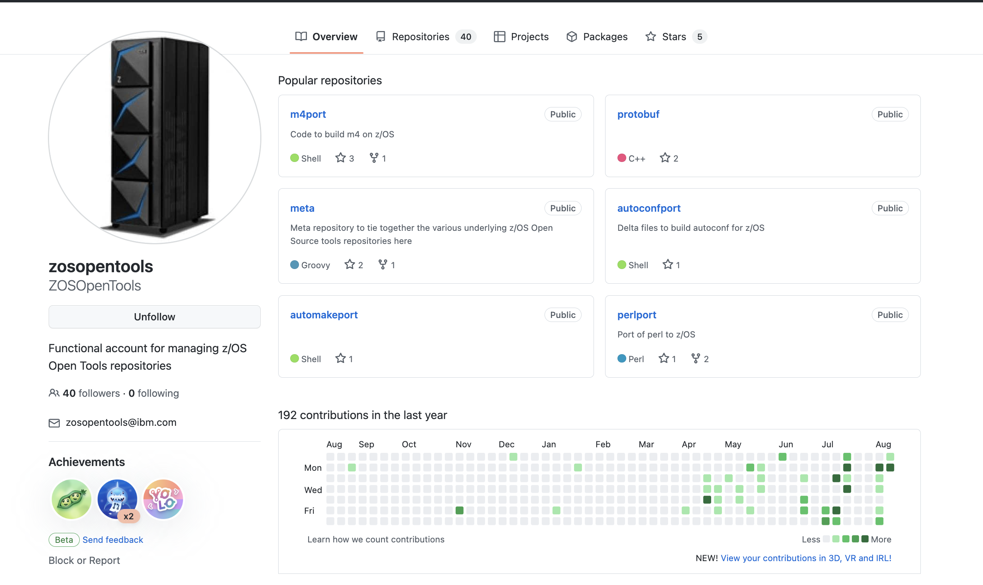
DEMO
z/OS fits into Open Source, not the other way around

Slide 9

We need your help! How do you get involved?
Get involved either as a creator, or a consumer, of z/OS Open Source Technology
Do you have access to a z/OS machine?
Yes:
Then visit to our Getting Started docs and get started today!
No:
Email fultonm@ca.ibm.com to be considered for z/OS system access
What should I get started with?
Visit our discussions page for a list of projects and availabilities:
https://github.com/ZOSOpenTools/meta/discussions
Got an idea? Create a discussion
Visit our help wanted issues: https://github.com/search?q=user%3AZOSOpenTools+repo%3Ahttps%3A%2F%2Fgithub.com%2FZOSOpenTools+label%3A%22help+wanted%22&type=Issues&ref=advsearch&l=&l=
Thank you to our existing Contributors: Jeff Shimoda, Fangbo Meng, Sean Perry, CW Cheung, Nate Myers, and many others!
z/OS fits into Open Source, not the other way around

Slide 10
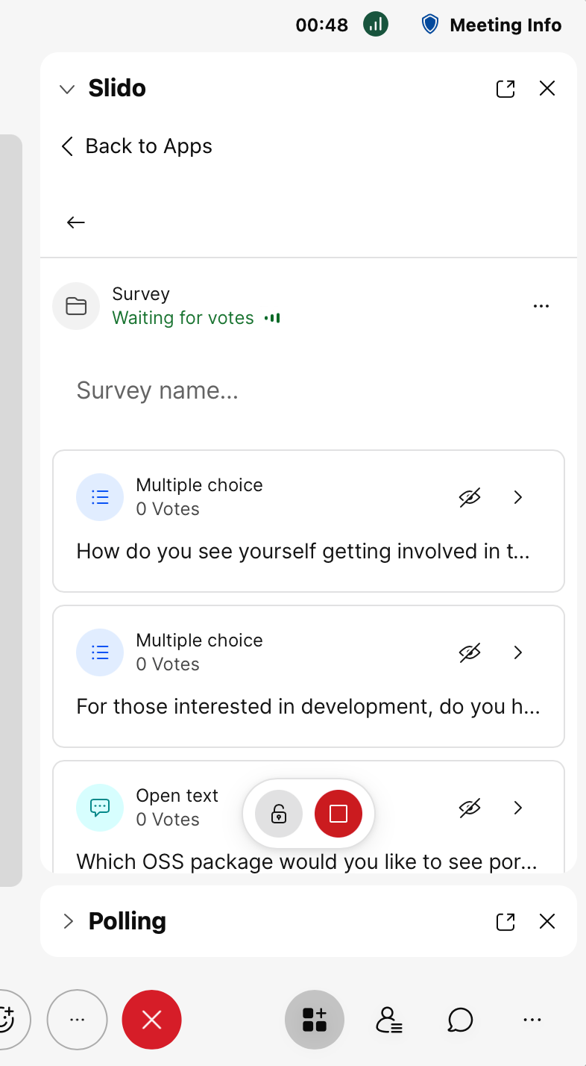
Survey
z/OS fits into Open Source, not the other way around
You can post feedback in our discussion page as well:
https://github.com/ZOSOpenTools/meta/discussions/categories/guild-feedback

Slide 11
We’ll see you next month! Q/A

